Slide 1

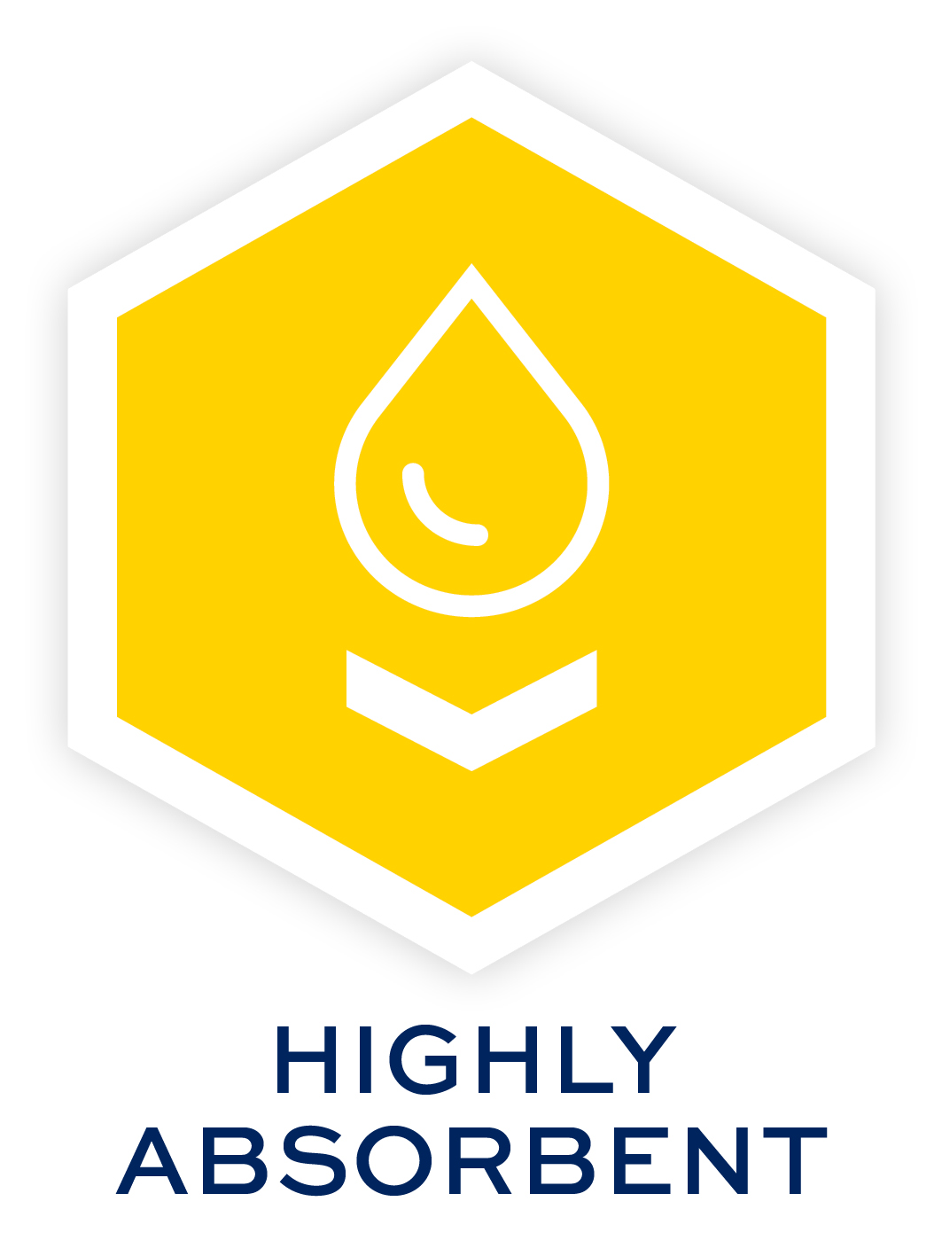



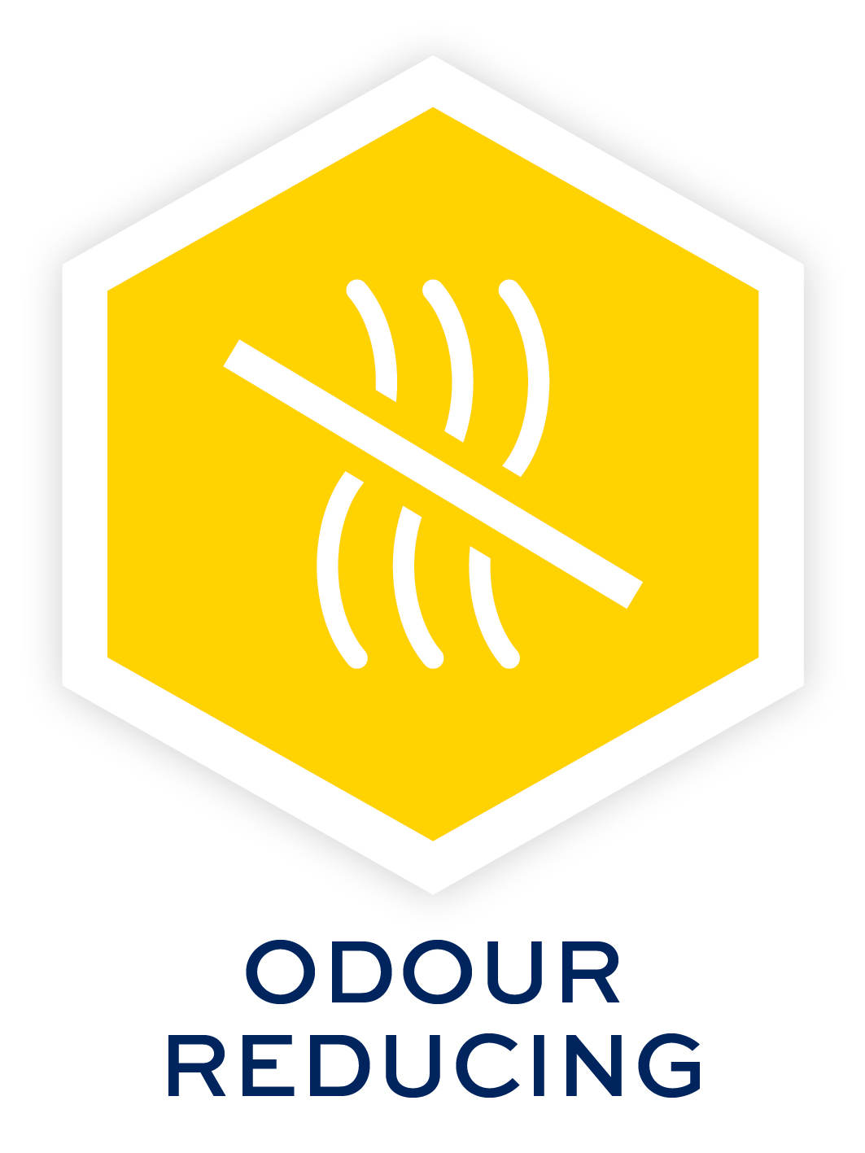
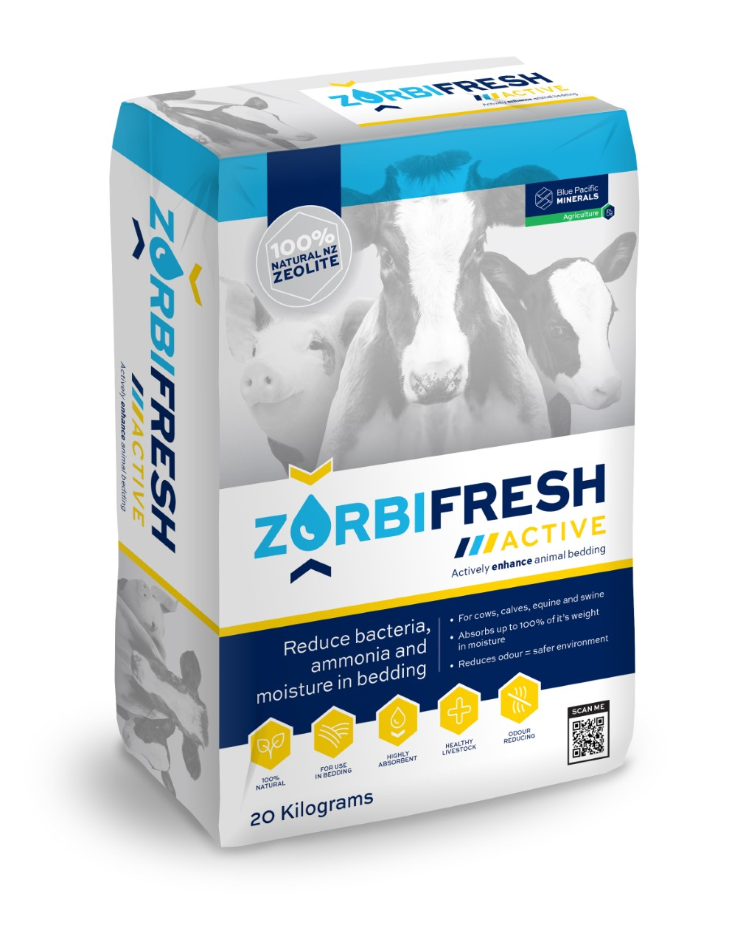


REDUCE BACTERIA, AMMONIA AND MOISTURE IN BEDDING
LABORATORY TESTED
ZorbiFresh™ Active has been tested using the industry standard laboratory efficacy evaluation test.
ZorbiFresh™ Active is 100% effective against Staph aureus and E. coli after 1 hour exposure.
Organic soiling of the bedding reduced the efficacy of ZorbiFresh™ Active after 1 hour exposure but 100% kill was achieved after 24 hours exposure.
ZorbiFresh™ Active kills bacteria such as Staph aureus and E. coli and other gram negative and gram positive bacteria.
DIRECTIONS FOR USE
From 250g to 500g per square meter of animal bedding.
Housed dairy cows once a day during times of bacterial challenge.
For other applications 1 to 2 times a week depending on stocking rate / moisture / ammonium and bacterial levels.
DO NOT feed to animals, although it is non toxic if accidentally ingested.
For use on all bedding types.
    INGREDIENTS
    Natural BPM Zeolite from New Zealand
    Oxone
ZORBIFRESH™ ACTIVE HELPS WITH
  A bedding additive for cows, calves, goats, sheep, equine and swine
  Absorbs up to 199% of it’s weight in moisture
  Reduces odour for a safer environment
  Starts killing bacteria (including Staph aureus and E. coli) as soon as it is applied and keeps killing beyond 24 hours
  WHY USE ZORBIFRESH™ ACTIVE?
  ZorbiFresh™ Active can be used as part of a regular process to keep calf pens clean and disease free, but is also highly effective in larger doses post a bacterial outbreak.
  ZorbiFresh™ Active starts killing bacteria (including Staph.Aureus and E.coli) as soon as it is applied and keeps killing beyond 24 hours.
  ZorbiFresh™ Active absorbs up to 199% of its weight in moisture, soaking up ammonia and nitrates. This prevents ammonia from turning into ammonium and keeping the air fresher for longer, healthier for both animals and workers.
HEALTH AND SAFETY
  Material safety data sheets are available on request.
For more information visit www.calving.nz
Code | Pack size
AGRI-0024 | 20 Kilograms
AGRI-0025 | 1 Tonne

